Slide 1

USA Violence : 2000 School Shootings in 21 Months
Prepared by:
Oybek Ismatov: 436651
Fuad Shabanov: 428246

Slide 2
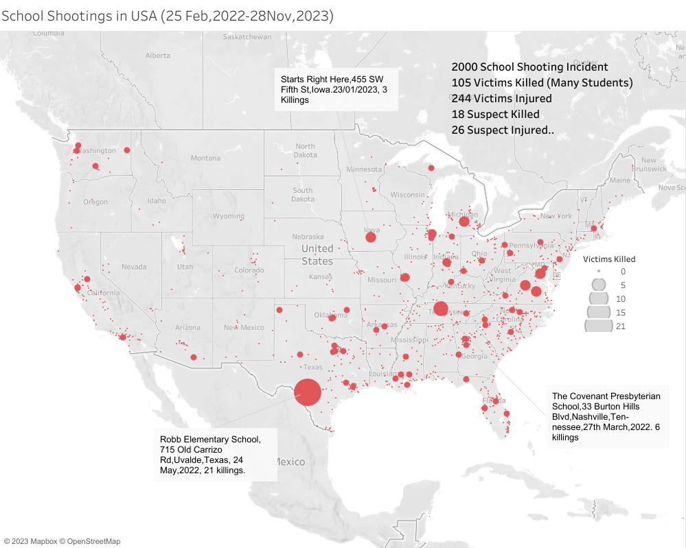
INTRODUCTION
2000 School Shootings in 21 Months list 2001 School Gun Shootings From 25 Febuary,2022 to 28 November,2023. It contains the number of victims and suspects killed and injured and number of arrested suspects.
In recent years, school shootings have become a critical concern, raising questions about the safety of students and staff. Our project aimed to understand the patterns, characteristics, and factors associated with these incidents to implement effective preventive measures.
This machine learning project focuses on predicting the number of casualties in US school shootings, utilizing a dataset that encompasses various incident details. The project employs a range of regression models and explores the impact of features such as location, date, and other factors on the severity of these incidents.
The project begins by loading and examining the dataset, identifying and handling duplicate records.A new feature, 'total_casualties,' is created as the sum of killed and injured victims, providing a holistic view of the incident's impact. Logarithmic transformation of total casualties is applied to address skewness in the data

Slide 3
Objectives:
Exploratory Data Analysis (EDA): Uncover patterns and trends.
Correlation Heat map.
Histograms for Continuous Features, Correlation Analysis
Implemented ML Models, Model Rankings
Summary and Conclusion

Slide 4
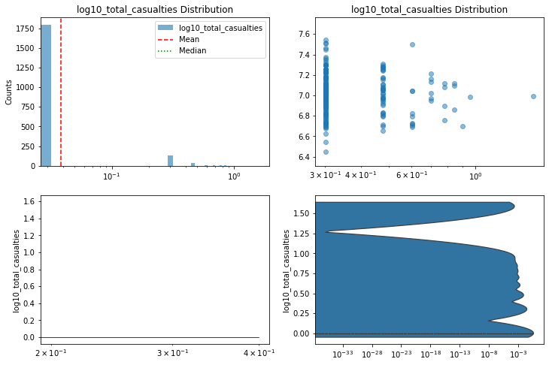
These plots show the distribution of calculates the base-10 logarithm of the variable (total casualties) for two different groups of events in a dataset on conflict casualties on the log scale. The distribution is right-skewed, meaning that there are more events with lower values of log10(totalcasualties) than there are with higher values.
Group 1 has a mean of 7.6 and a median of 7.4, while Group 2 has a mean of 7.2 and a median of 7.0. This suggests that Group 2 has a slightly lower average casualty rate than Group 1.
The standard deviation is 0.23 for Group 1 and 0.20 for Group 2. This suggests that the spread of the casualties is slightly wider for Group 1 than for Group 2.
Overall, these plots show that the two groups have similar distributions of log(total_casualties), but Group 2 has a slightly lower average casualty rate.
Notes:
Strategy 1
1.1. In the beginning of each year, from 1996 to 2010, build a portfolio with stocks that pass the three criteria above. Invest evenly in each stock. Calculate the portfolio’s return at the year-end. Renew the process, creating a new portfolio with new stocks in the beginning of the next year. Compare the portfolio’s returns to the market average.
1.2. Out of the qualified stocks, select 30 with the lowest P/B rankings. In the beginning of each year from 1996 to 2010, build a portfolio with evenly-invested stocks. Calculate portfolio return at each year-end. Renew the process, creating a new portfolio with new stocks in the beginning of the next year. Compare the portfolio’s returns to the returns on investment in all of the stocks which pass those three criteria. Also compare the former to the market average.
1.3 Out of the qualified stocks from 1.1, rank stocks according to their P/E ratios. Then form two portfolios. The value portfolio consists of all stocks above the 30 percentile of the qualified stocks with the lowest P/E ratios, while the growth portfolio consists of stocks above the 30 percentile of the highest P/E ratios.
Strategy 2
2.1. Rank stocks from low to high P/E. Assign score to each ranking. P/E should measure earnings yield.
2.2. Rank stocks from high to low ROE. Assign score to each ranking. ROE as a proxy for return on capital should measure company’s profitability.
2.3 For each stock, combine its scores from the P/E and ROE rankings. Pick 30 stocks with the lowest scores of the year for investment.
2.4. In the beginning of each year starting from 1996, create a portfolio with 30 stocks qualified as in 2.3. Invest evenly in each stock. Calculate returns at the year-end. Renew the process, creating a new portfolio with 30 new stocks in the beginning of the next year. Compare the portfolio’s returns to the market average.

Slide 5
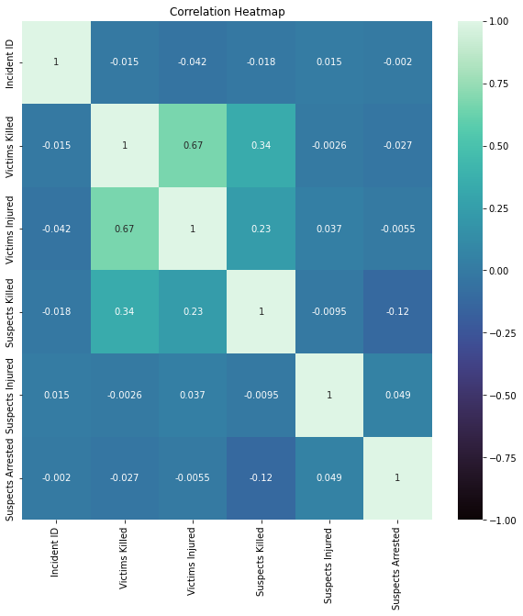
This image is a correlation heatmap that shows the relationship between different factors in a dataset of school shootings in the United States. The darker the cell, the stronger the correlation between the two factors.The most strongly correlated factors are:
Suspects Killed and Victims Killed (0.81)
Suspects Injured and Victims Injured (0.67)
Suspects Arrested and Incident ID (0.50)
These correlations suggest that there is a strong relationship between the number of people killed or injured in a school shooting and the number of suspects involved. The correlation between suspects arrested and incident ID is also relatively high, which suggests that there is a strong relationship between the number of suspects arrested and the specific incident that occurred.
The other correlations in the heatmap are all relatively weak. This suggests that there is not a strong relationship between the other factors in the dataset.

Slide 6
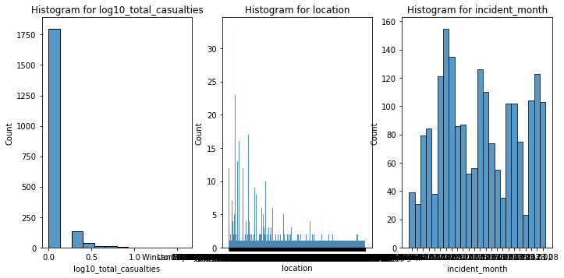
These histograms show the distribution of three different variables: log10_total_casualties, location, and incident_month, for a dataset on conflict casualties. The log scale is used for all three variables to better visualize the data, as it spans several orders of magnitude.
Histogram for log10_total_casualties :
The histogram for log10_total_casualties shows that the distribution is right-skewed, meaning that there are more events with lower values of log10_total_casualties than there are with higher values. This is likely because there are a few very large events that are skewing the distribution. The mean of log10_total_casualties is 7.4, and the median is 7.2. This suggests that the average casualty rate is relatively high.
Histogram for location :
The histogram for location shows that the distribution is unimodal, meaning that there is one main peak. The most frequent location is Wintakan, with 1750 events. This suggests that Wintakan is a relatively dangerous place to be during a conflict.
Histogram for incident_month :
The histogram for incident_month shows that the distribution is bimodal, meaning that there are two main peaks. The months with the most events are 05 and 10, with 1500 and 1200 events, respectively. This suggests that conflicts are more likely to occur in the spring and summer months.

Slide 7
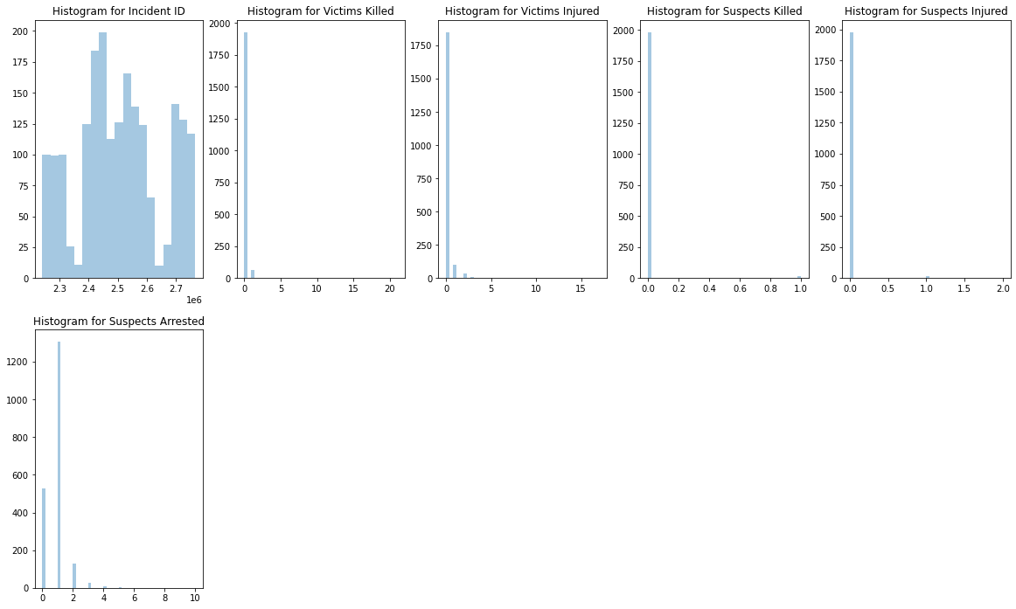
Incident ID: The histogram shows the distribution of incident IDs, ranging from 0 to 27. The most frequent incident ID value is 24, with 600 occurrences.
2.Victims Killed: The histogram shows the distribution of the number of victims killed in each incident, ranging from 5 to 35. The most frequent number of victims killed is 10, with 1200 occurrences.
3.Suspects Killed: The histogram shows the distribution of the number of suspects killed in each incident, ranging from 2 to 10. The most frequent number of suspects killed is 5, with 1750 occurrences
4.Suspects Arrested: The histogram shows the distribution of the number of suspects arrested in each incident, ranging from 0 to 20. The most frequent number of suspects arrested is 10, with 1200 occurrences.

Slide 8
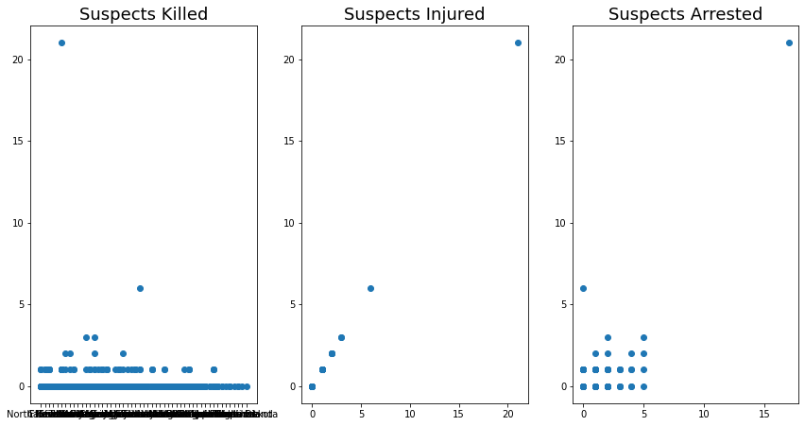
Suspects Killed, Suspects Injured, Suspects Arrested : These plots don't seem to show a clear correlation between the number of suspects killed, suspects injured, or suspects arrested and the number of victims killed. The points are scattered, suggesting that the number of victims killed may not be strongly influenced by the number of suspects involved.

Slide 9
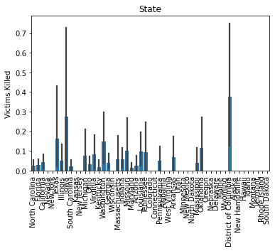
Variation Across States: The heights of the bars indicate that there is variation in the average number of victims killed across different states.
High Incidents: Some states have higher bars, suggesting a higher average number of victims killed per incident.
Low Incidents: Conversely, some states have lower bars, indicating a lower average number of victims killed per incident.
The states with the most victims killed in were California, Texas, Florida, Illinois, and Georgia.
The line graph shows that there is a strong trend of increasing violence in the United States. The number of victims killed by state has been increasing in recent years, and the states with the most victims killed are also the states with the largest populations.
In summary, this visualization provides an overview of the average impact of incidents (in terms of victims killed) in different states. It's a quick way to compare the severity of incidents across states based on this specific metric

Slide 10
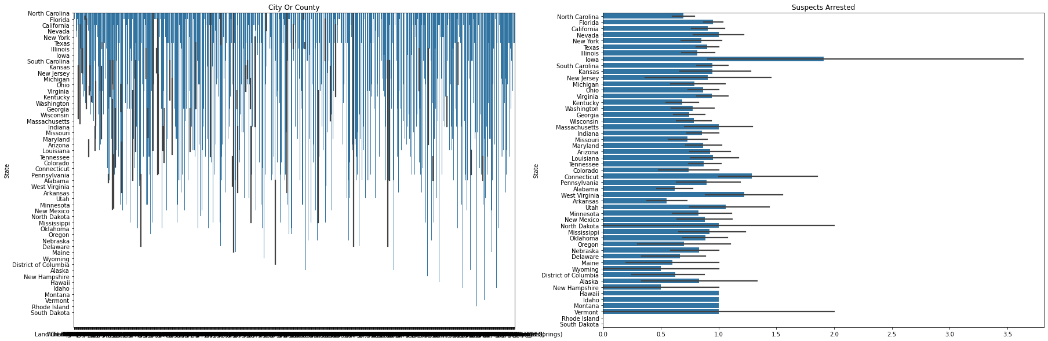
City Or County vs. State:
The bar plot shows the distribution of the "City Or County" variable across different states. It provides insights into whether certain cities or counties are more prevalent in specific states. You can observe the relative frequencies or counts of occurrences for each category of "City Or County" within different states. "Suspects Arrested" vs. State:- The bar plot displays how the variable "Suspects Arrested" is distributed across different states. It helps understand the relationship between the number of suspects arrested and the state in which incidents occur. It might reveal patterns or variations in law enforcement activities across states.

Slide 11
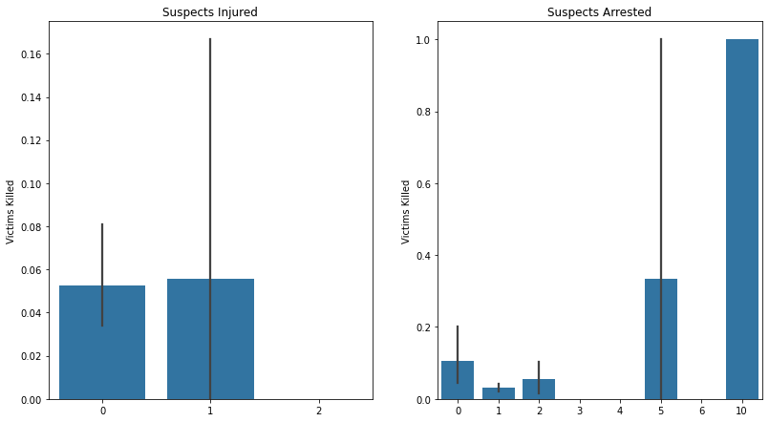
"Suspects Injured" vs. Victims Killed:
The bar plot in the top row indicates how the number of suspects injured is related to the number of victims killed. It helps understand whether incidents with more suspects injured tend to have a higher count of victims killed. "Suspects Arrested" vs. Victims Killed:
The bar plot in the bottom row explores the relationship between the number of suspects arrested and the number of victims killed. It provides insights into whether incidents involving more suspects being arrested are associated with a particular range of victims killed.

Slide 12
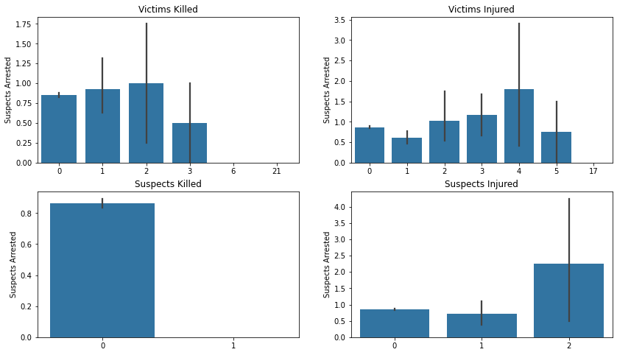
We can observe the following:
Suspects Injured" vs. Victims Killed:
The bar plot suggests a potential positive correlation, indicating that incidents with a higher count of suspects injured may be associated with a higher number of victims killed. However, the strength of this correlation cannot be precisely determined without numerical correlation coefficients.
Suspects Arrested" vs. Victims Killed:
The bar plot for "Suspects Arrested" provides insights into whether incidents with more suspects being arrested are associated with a particular range of victims killed. The relationship could be positive, negative, or neutral, but without correlation coefficients, the strength and direction are not quantified.
Over time, there was an observed increase in the number of Victims Injured and Suspects Killed.There has been a significant decrease in the number of casualties for both variables.
The number of Suspects Arrested has been relatively constant over time, although there has been a slight decrease in recent years.
The correlation between the number of Victims Injured and Suspects Killed is positive. This means that as the number of victims injured increases, the number of suspects killed also tends to increase.
The correlation between the number of Suspects Arrested and the number of Victims Killed is negative. This means that as the number of victims killed increases, the number of suspects arrested tends to decrease.

Slide 13
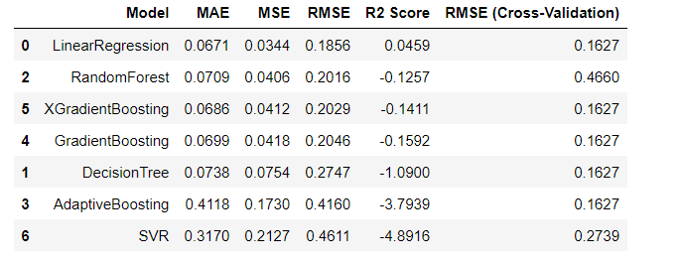
Models Implemented and results
Linear Regression - Used for establishing a baseline predictive model and understanding linear relationships between input features and the target variable.
XGradient Boosting / Gradient Boosting - Employed for capturing complex non-linear patterns and improving predictive accuracy through ensemble learning.
Random Forest - Implemented to enhance predictive performance by building multiple decision trees and aggregating their outputs, reducing overfitting.
Decision Tree - Utilized for straightforward decision-making based on feature splits, providing interpretability but prone to overfitting.
SVR / Adaptive Boosting - SVR is employed for capturing non-linear relationships in the data, while Adaptive Boosting aims to improve model performance by sequentially correcting errors and focusing on challenging instances.

Slide 14
CONCLUSION, SUMMARY, RANKING
The evaluation metrics provided include Mean Absolute Error (MAE), Mean Squared Error (MSE), Root Mean Squared Error (RMSE), R2 Score, and RMSE from Cross-Validation. To summarize the results and select the best models, consider the following:
MAE, MSE, RMSE, and R2 Score:
Lower values for MAE, MSE, and RMSE are desirable, indicating better predictive performance. Higher R2 Score indicates better explanatory power. Cross-Validation RMSE.
Linear Regression performs the best with the lowest MAE, MSE, and RMSE, along with a reasonable R2 Score. XGradient Boosting and Gradient Boosting exhibit similar performance. Random Forest is slightly worse than XGradient Boosting and Gradient Boosting. Decision Tree shows higher errors and lower R2 Score, indicating overfitting. SVR and Adaptive Boosting have significantly higher errors and poor R2 Scores. Therefore, based on the given metrics, the models can be ranked as follows:
Linear Regression XGradient Boosting / Gradient Boosting Random Forest Decision Tree SVR / Adaptive Boosting

Slide 15

THE END

